Slide 1
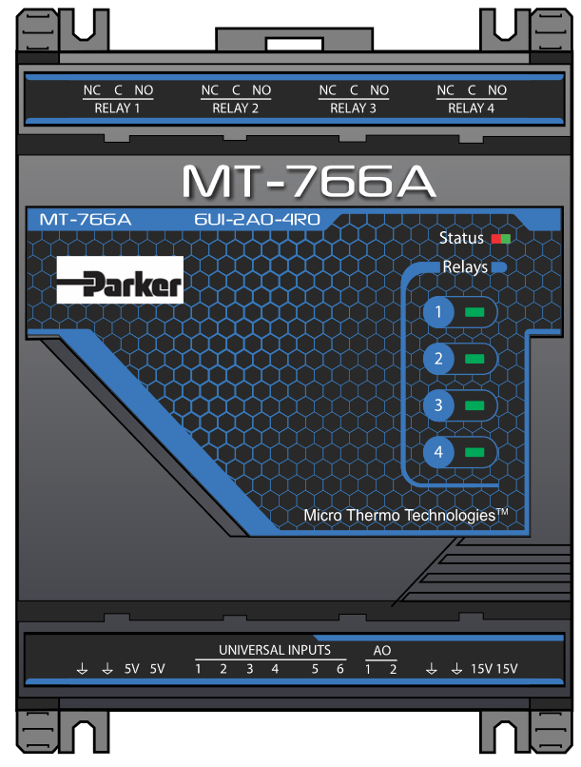
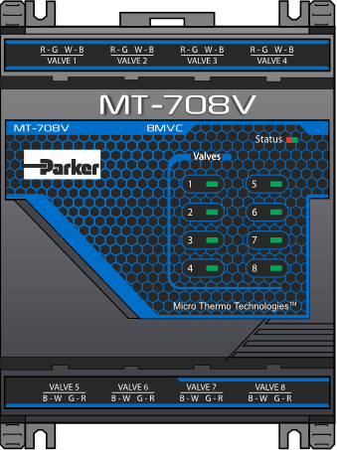
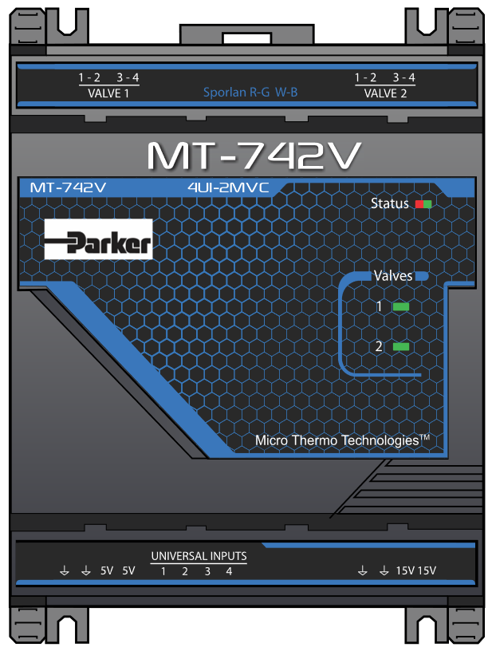
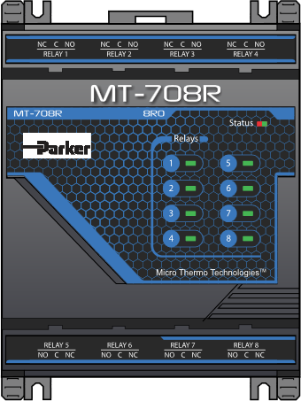
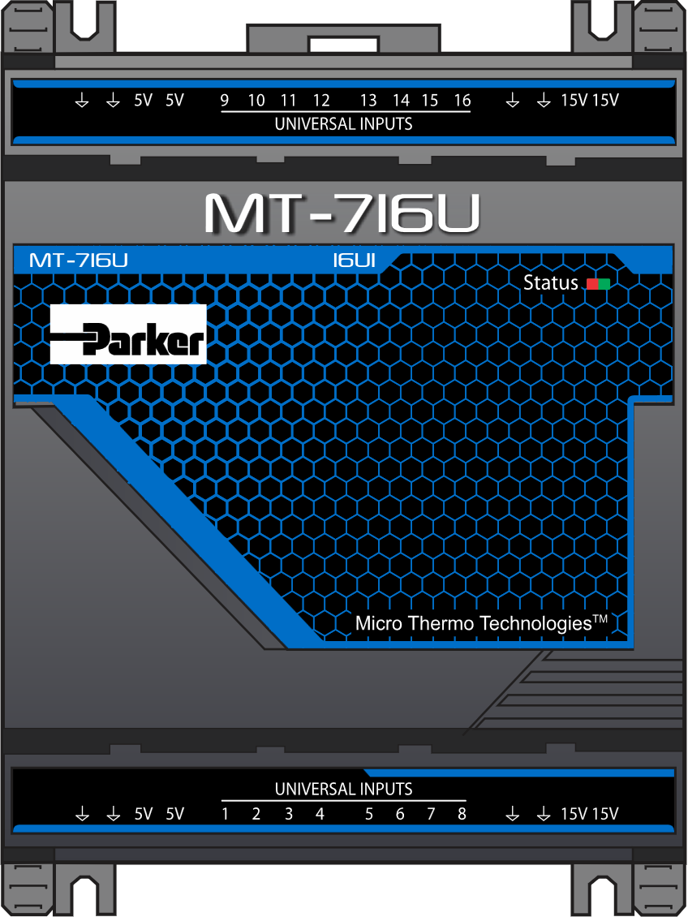
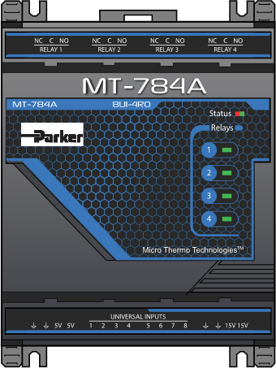
MT700 Modules Firmware Porting
Scope
To port the existing MT700 firmware from ST controller to Geehy controller using GEEHY peripheral libraries for six expansion modules.
Due to supply issues with ST Microelectronics, the GEEHY microcontroller has been specified as an alternative part to alleviate the supply constraints.
Challenges
Common source for both ST and GEEHY. Code changes for GEEHY shouldn’t change the ST hex file size.
Environment
Eclipse IDE
32-bit ARM Cortex Microcontroller
J-Link Debugger
Modbus RTU
Modbus Poll application
Benefits and Improvements
Solution
MT700 product continuity without any hardware changes in PCB with new GEEHY microcontroller.
Ported firmware with complete testing of the product.

